Slide 1
Model Free Prediction Methods: Monte Carlo and Temporal Difference Algorithms
Lecture 4
Subir Varma

Slide 2
Office
Room 405C, Computer Science Bldg
Office Hours: 2PM-5PM, weekdays till Feb 23

Slide 3
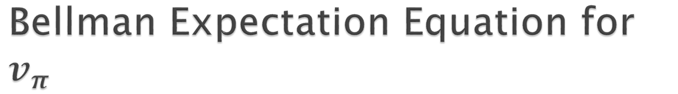
Bellman Expectation Equation for $v_{π}$
r
Principle of Optimality
Decompose the problem into:
A smaller problem that is easy to solve, and
A bigger problem, that is assumed to be solved
Put the 2 parts together to solve original problem
Value Function for State s = One Step Reward +Value Function for Next State s’

Slide 4
Iterative Policy Evaluation
Every state gets its turn being the root
Bellman
Expectation
Equation
Notes:
Back up the VFs at the successor state to compute v(s) at the root
Each single state gets its turn being the root
This process is guaranteed to converge to the true VF

Slide 5
Policy Iteration – Find Best Policy
This process is guaranteed to converge to optimal Value Function V* and thus the optimal policy

Slide 6
Generalized Policy Iteration
Find Heuristics to be able to solve Problems with huge
number of states and/or actions
1-step Policy Evaluation
,
Iterate only a few times, even just once (k = 1)
Don’t have to update all the states in each iteration update only those that are actually visited

Slide 7
Value Iteration – Find Best Policy
Turn the Bellman
Optimality Equation into an Iterative Update

Slide 8
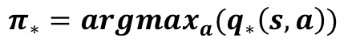
Finding the Optimal Policy
$$π_{∗}={argmax}_{a}(q_{∗}\left(s,a\right))$$

Slide 9
But…
These algorithms are dependent on the knowledge of the MDP Model P

Slide 10
Motivation
Policy Iteration and Value Iteration Algorithms don’t work if:
The Environment Model is not known, or
The number of states is extremely large
How can we find the Value Function and the Optimal Policy under these conditions
Solution: Instead of Computing these functions from a Model, Learn them from Experience!

Slide 11
Motivation (cont)
Still Doing Policy
Iteration
Experience: Sample sequences of States, Actions and Rewards (S, A, R, S’)
The Experience can be either Real or Simulated

Slide 12
Model Free Reinforcement Learning
Model for the Environment not known
Agent uses its interaction with environment to figure out its Value Function and Optimal Policy
This Lecture: Given a Policy, how do we figure out the Value Function, without knowing the model
Next lecture: How to find Optimal Policy, without knowing the model

Slide 13
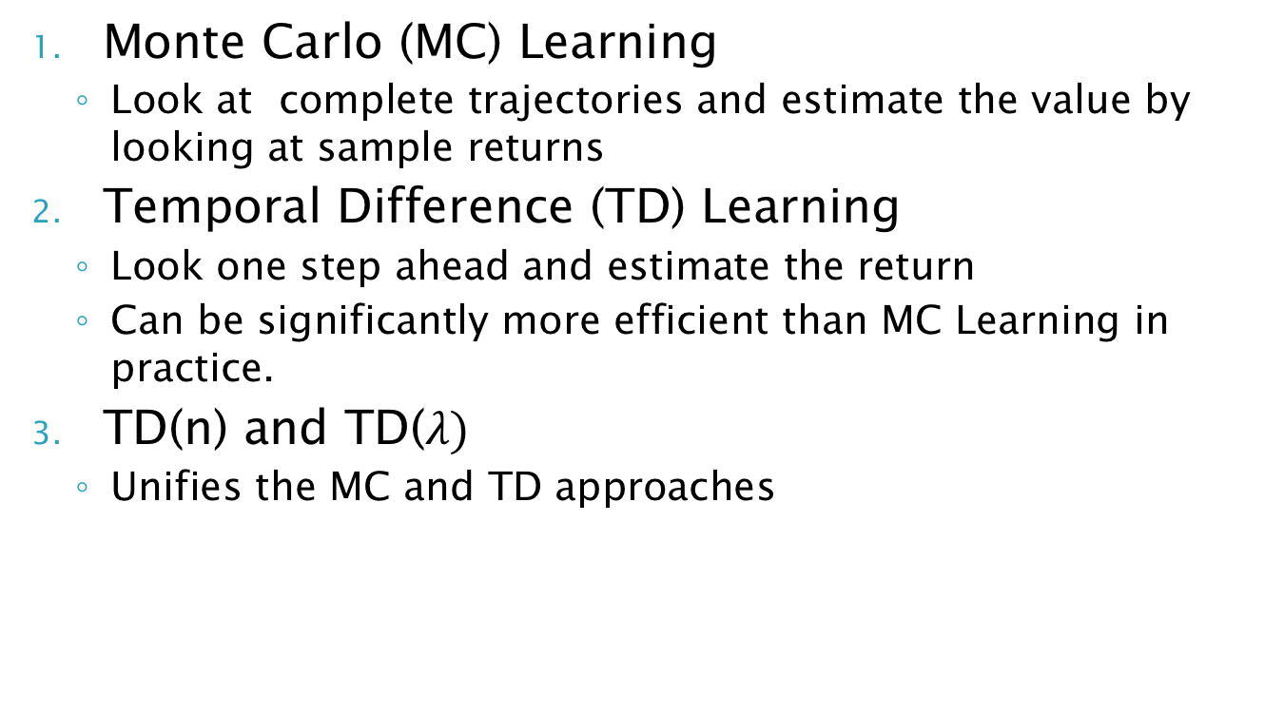
This Lecture
Monte Carlo (MC) Learning
Look at complete trajectories and estimate the value by looking at sample returns
Temporal Difference (TD) Learning
Look one step ahead and estimate the return
Can be significantly more efficient than MC Learning in practice.
TD(n) and TD($λ)$
Unifies the MC and TD approaches
Notes:
What to do in situations in which the model is not available
Agent has to figure out the optimal way to behave in the absence of any information about the environment

Slide 14
Monte Carlo Reinforcement Learning

Slide 15
Dynamic-Programming Backup
Full Backup

Slide 16
Monte Carlo Backup
Sample Backup
Update made at end of an Episode
Don’t Need the Model Anymore!

Slide 17
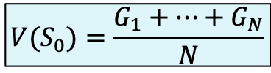
Monte Carlo Policy Evaluation
$$V(S_{0})=\frac{G_{1}+…+G_{N}}{N}$$
Notes:
Two ways to get means for all states:
First visit MC
Every Visit MC

Slide 18
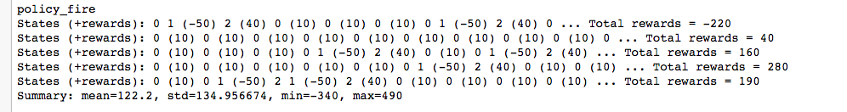
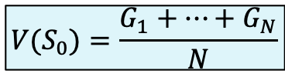
Example of MC: MDP Returns
1.0
0.8
a₁
a₁
0.1
0.1
R = +32
s₀
a₂
0.2
s₁
R = -50
s₂
a₂
1.0
R = +7
0.8
a₀
0.3
a₀
1.0
$$V(S_{0})=\frac{G_{1}+…+G_{N}}{N}$$
0.7
Sample returns, starting from state s₀ and $γ=1,$
Average return computed from 1000 episodes and 100 steps per episode

Slide 19
Monte Carlo Reinforcement Learning

Slide 20
Computing the Empirical Mean
Two Techniques
First Visit Monte Carlo
Every Visit Monte Carlo

Slide 21
First Visit Monte Carlo Policy Evaluation
How quickly does it converge: Variance of error reduces as 1/n
We are sampling instead of doing a full sweep and this breaks the the dependence on the size of the problem state space

Slide 22
First Visit Monte Carlo

Slide 23
Every Visit Monte-Carlo Policy Evaluation
In one episode, V(s) can be updated multiple times (for a given s)

Slide 24
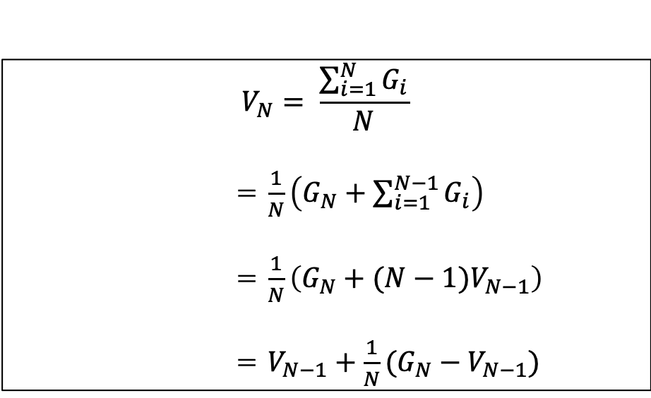
Incremental Mean Update
$$V_{N}= \frac{\sum_{i=1}^{N}{G_{i}}}{N}$$
= $\frac{1}{N}\left(G_{N}+\sum_{i=1}^{N−1}{G_{i}}\right)$
= $\frac{1}{N}\left(G_{N}+(N−1)V_{N−1}\right)$
= $V_{N−1}+\frac{1}{N}(G_{N}−V_{N−1})$
New Estimate = Current Estimate + Error Term
Notes:
Error Term = What actually happened – What we thought would happen

Slide 25
Incremental Monte Carlo Updates

Slide 26
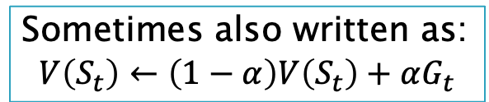
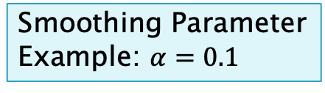
Exponential Smoothing
Smoothing Parameter
Example: $α=0.1$
Leads to an exponential forgetting rate
This works better in practice, since with policy improvements the system keeps changing
Sometimes also written as:
$$V\left(S_{t}\right)←\left(1−α\right)V\left(S_{t}\right)+αG_{t}$$
$$V_{n}=α{(1−α)}^{n}G_{0}+{α(1−α)}^{n−1}G_{1}+…+α\left(1−α\right)G_{n−1}+{αG}_{n}$$

Slide 27
First Visit Monte Carlo with Exponential Smoothing

Slide 28
MC Estimate for a Single State
Sample Backup
Computational expense of estimating the value of a single state is independent of the number of states

Slide 29
Temporal Difference (TD) Reinforcement Learning

Slide 30
Dynamic-Programming Backup
Full Backup

Slide 31
Monte Carlo Backup
Sample Backup
Update made at end of an Episode

Slide 32
Issue with MC Learning
Having to wait until end of episode to compute update
Downsides:
What if something “bad” happens at end of episode
Some MDPs are continuous, i.e., never ending episodes

Slide 33
Temporal-Difference Backup
Update made at every step (S_{t}, A, R, S_{t+1})
Sample Backup

Slide 34
Temporal-Difference (TD) Learning
Similar to Monte Carlo
Different from Monte Carlo
Similar to Dynamic Programming

Slide 35
Derivation of TD Update Rule
With MC
With TD
Best estimate of G_{t}

Slide 36
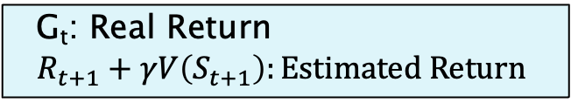
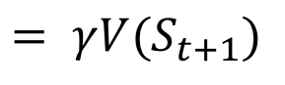
TD Update
1-step
reward
Estimated Reward for rest of trajectory
$$= γV(S_{t+1})$$
G_{t}: Real Return
$$R_{t+1}+γV\left(S_{t+1}\right):Estimated Return$$

Slide 37
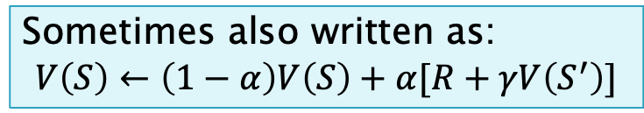
TD Algorithm
Sometimes also written as:
$$V\left(S\right)←\left(1−α\right)V\left(S\right)+α[R+γV\left(S^{′}\right)]$$

Slide 38
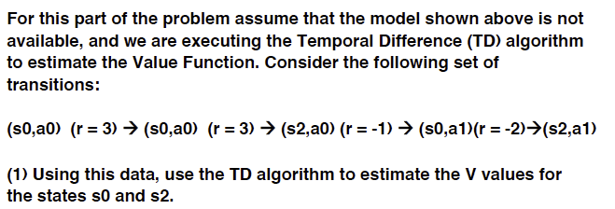
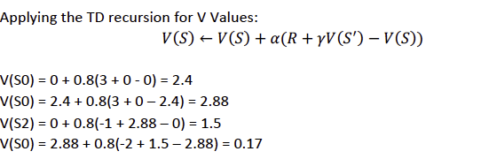
TD Algorithm

Slide 39
Advantages and Disadvantages of MC vs TD

Slide 40
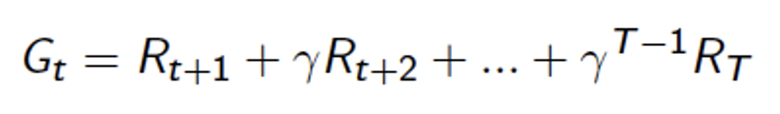
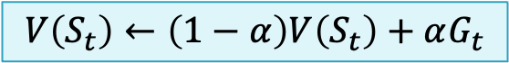
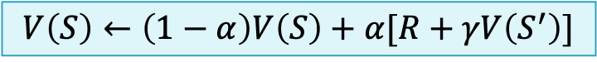
Bias/Variance Trade-Off
Leads to faster convergence
$$V\left(S_{t}\right)←\left(1−α\right)V\left(S_{t}\right)+αG_{t}$$
High Variance
Lower Variance
$$V\left(S\right)←\left(1−α\right)V\left(S\right)+α[R+γV\left(S^{′}\right)]$$
Notes:
MC: High Variance, no bias
TD: Low variance, biased; more efficient since it has lower variance

Slide 41
Bias/Variance Trade-Off
Notes:
MC: High Variance, no bias
TD: Low variance, biased; more efficient since it has lower variance

Slide 42
Advantages and Disadvantages of MC vs TD (2)

Slide 43
Random Walk Example

Slide 44
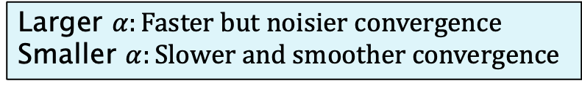
Random Walk: MC vs TD
TD converges much faster
Larger $α:Faster but noisier convergence$
Smaller $α:Slower and smoother convergence$

Slide 45
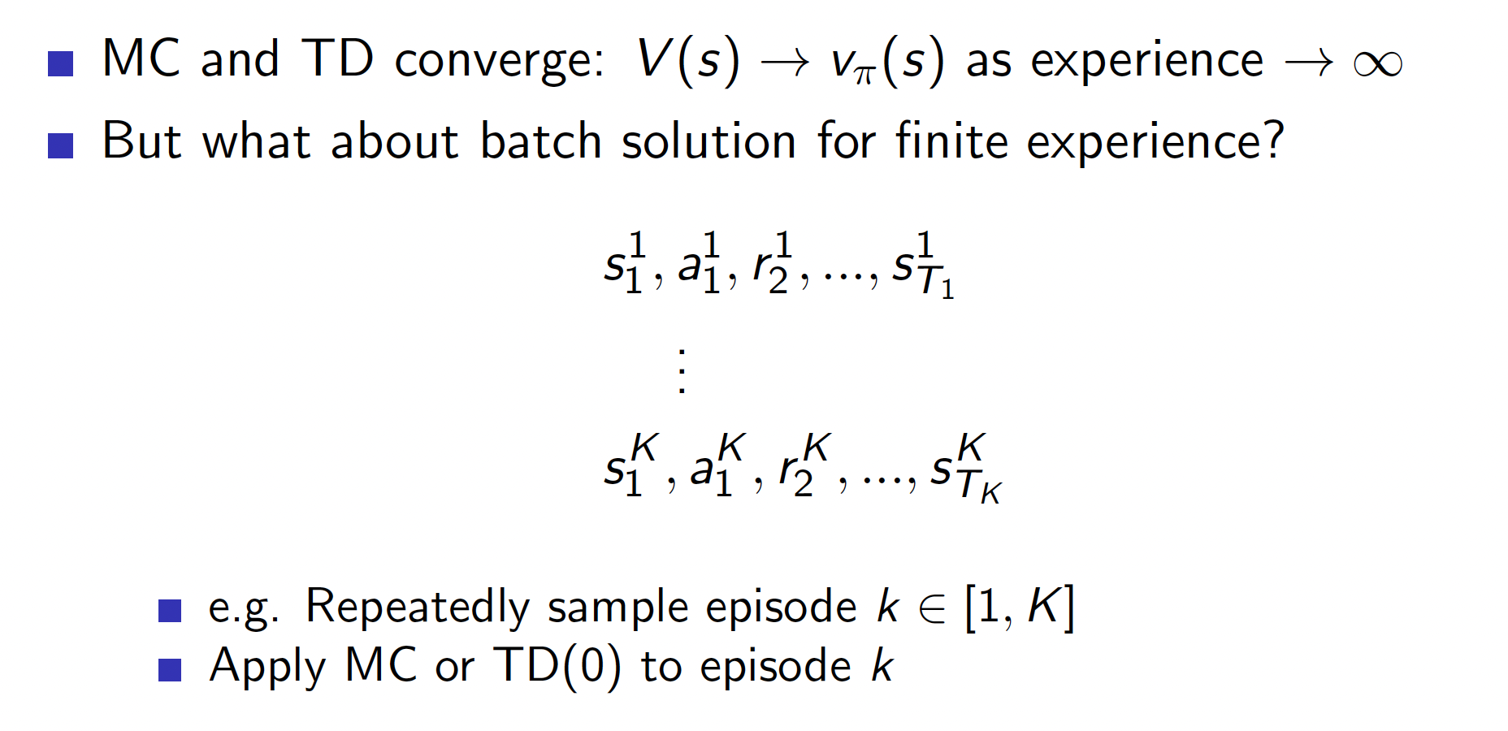
Batch MC and TD

Slide 46
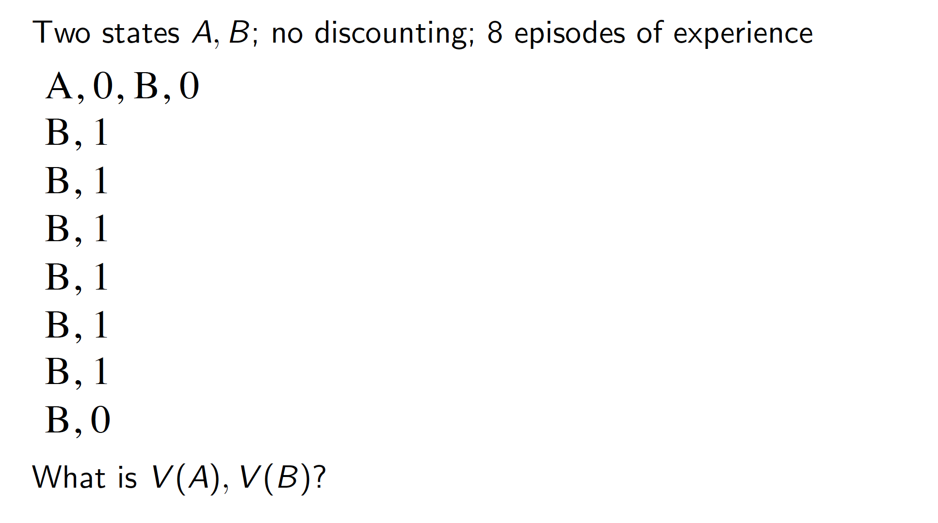
AB Example

Slide 47
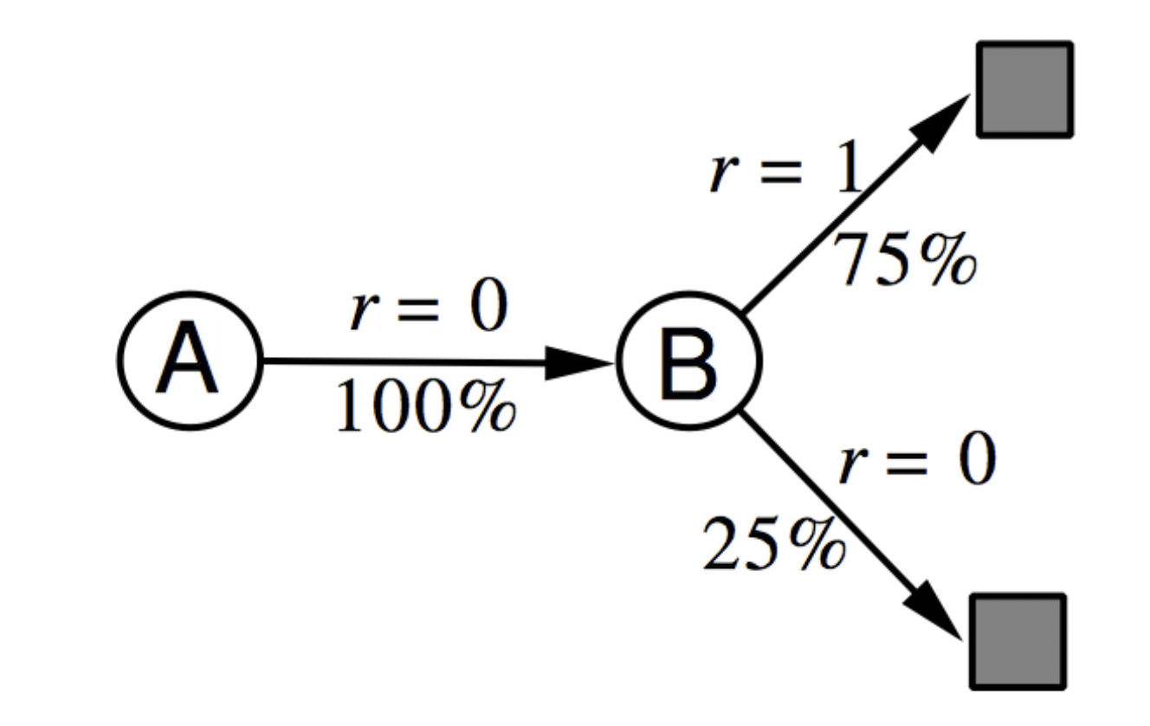
AB Example

Slide 48
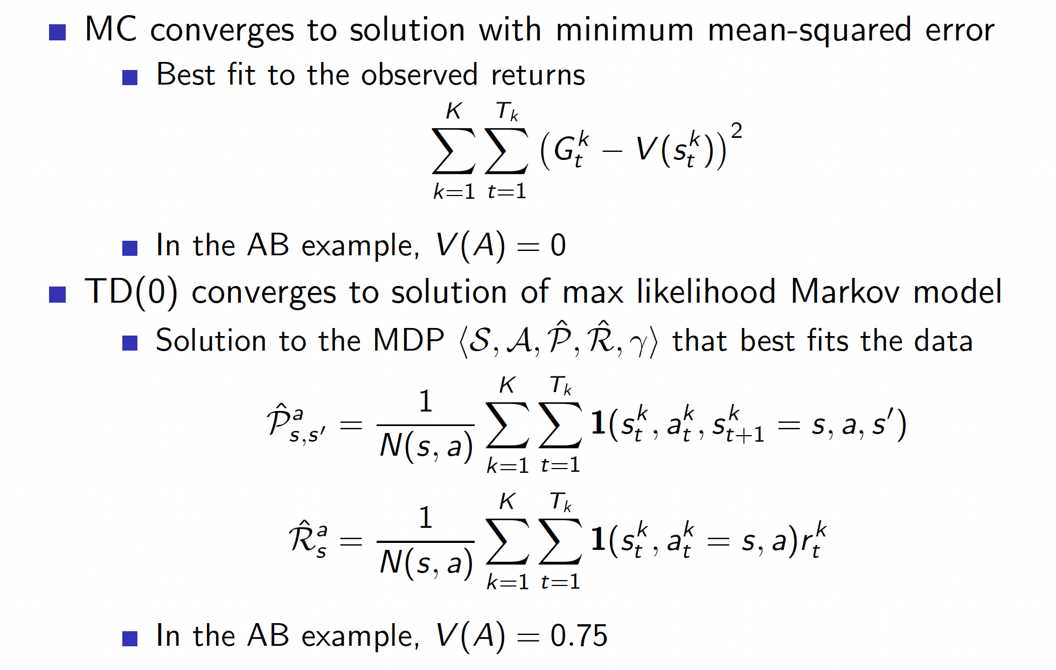
Convergence Properties

Slide 49
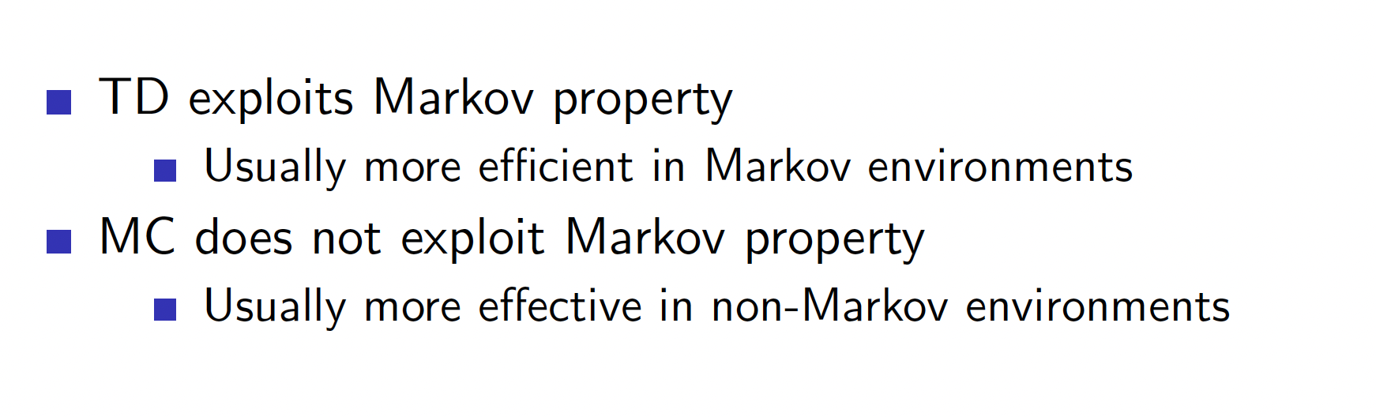
MC vs TD

Slide 50
Bootstrapping and Sampling
Notes:
Bootstrapping: We don’t use real returns – we use our own estimate of the VF instead

Slide 51
Unified View of Reinforcement Learning

Slide 52
n-Step Temporal Difference: TD(n)

Slide 53
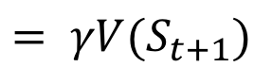
1-step Prediction
1-step
reward
Estimated Reward for rest of trajectory
$$= γV(S_{t+1})$$

Slide 54
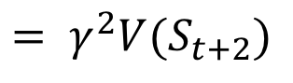
2-step Prediction
2-step
reward
Estimated Reward for rest of trajectory
$$= γ^{2}V(S_{t+2})$$

Slide 55
n-step Return

Slide 56
Large Random Walk Example
Notes:
MC has large error
n > 1 leads to better performance

Slide 57
Averaging n-step Returns

Slide 58
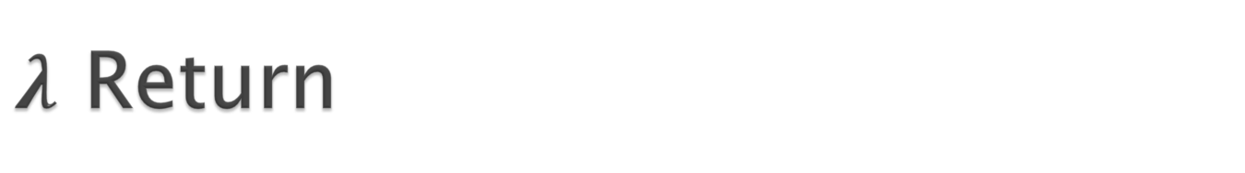
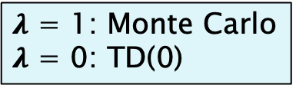
$λ$ Return
$λ$ = 1: Monte Carlo
$λ$ = 0: TD(0)

Slide 59
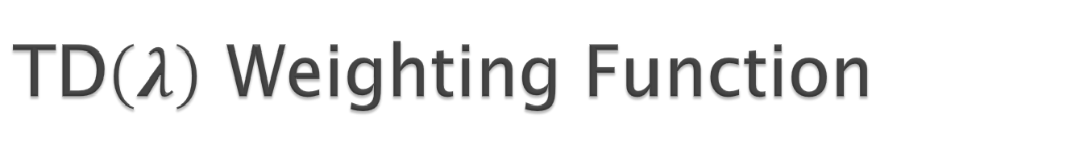
TD$\left(λ\right)$ Weighting Function

Slide 60
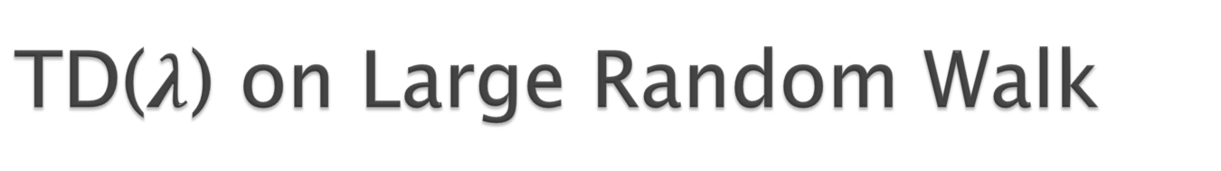
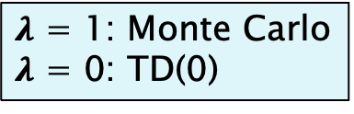
TD($λ$) on Large Random Walk
$λ$ = 1: Monte Carlo
$λ$ = 0: TD(0)

Slide 61
Further Reading
Sutton and Barto:
Chapter 5: Section 5.1
Chapter 6: Sections 6.1-6.3
Chapter 7: Section 7.1

Slide 62
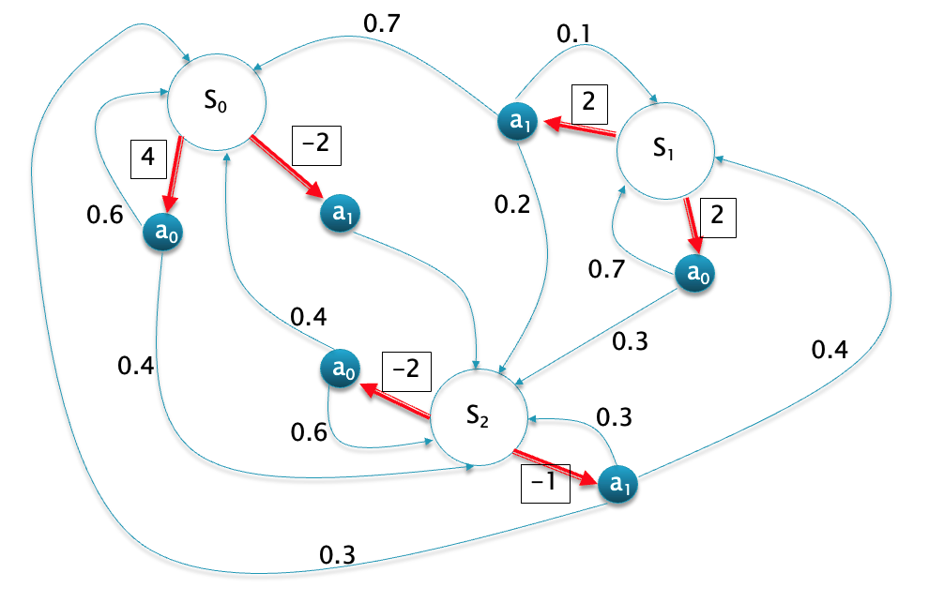
Example

